Slide 1










DHANAVANTRI
K Maneesh-1602-21-733-087
K Sai Teja-1602-21-733-114

Slide 2
ABSTRACT
Ayurveda, a traditional Indian medicine system with a rich history spanning millennia, possesses vast knowledge about herbs and formulations for various ailments. However, navigating this vast repository and accurately translating classical texts into actionable prescriptions remains a challenge. This presents an opportunity for technological intervention. We propose the development of a software tool that leverages natural language processing (NLP) and machine learning (ML) to bridge the gap between Ayurvedic classical texts and modern clinical practice.
This software aims to suggest drugs and formulations based on Ayurvedic classical texts and repositories for specific diseases or pharmacological properties. It likely utilizes Natural Language Processing (NLP) techniques to analyse and understand the vast knowledge contained within these ancient sources. Through IOT devices we take input regarding symptoms or desired effects, the software recommends suitable single herbs or formulations using a matching algorithm. Security and user authentication are crucial components to ensure data privacy and responsible use.

Slide 3
Introduction
Ayurveda, an ancient system of medicine originating in India, offers a holistic approach to health and wellness. Ayurvedic medicine focuses on balancing the body, mind, and spirit to prevent and treat illness. With its emphasis on natural remedies, dietary recommendations, lifestyle practices, and herbal supplements, Ayurveda aims to promote overall well-being and harmony within the body.
In this Presentation ,We will introduce an Ayurvedic Medicine Recommender, a tool designed to help individuals identify the most suitable Ayurvedic remedies based on their unique constitution, or 'dosha'. By leveraging the wisdom of Ayurveda and modern technology, this recommender aims to empower individuals to take charge of their health and incorporate Ayurvedic practices into their daily lives.

Slide 4
Litreature Survey
Artificial Intelligence and Challenges in Ayurveda Pharmaceutics: A Review:
Ancient Indian medicine, Ayurveda, focuses on promoting health and longevity. Its popularity is rising due to its safety and effectiveness. However, modern methods like Artificial Intelligence (AI) are needed to meet growing demand and address challenges in manufacturing Ayurvedic medicines. AI can integrate engineering principles to overcome these hurdles, potentially leading to wider global acceptance of Ayurveda.
Artificial intelligence in the sector of Ayurveda: Scope and opportunities:
Digital technologies like AI are crucial for achieving healthcare goals set by the UN. These technologies improve diagnosis, treatment, and overall health outcomes by enabling virtual care, data-driven decisions, and better communication across the healthcare system. The World Health Organization emphasizes using AI to empower patients and strengthen healthcare systems worldwide.

Slide 5

Problem Statement
This software aims to suggest drugs and formulations based on Ayurvedic classical texts and repositories for specific diseases or pharmacological properties. It likely utilizes Natural Language Processing (NLP) techniques to analyze and understand the vast knowledge contained within these ancient sources. Through user input regarding symptoms or desired effects, the software recommends suitable single herbs or formulations using a matching algorithm. Security and user authentication are crucial components to ensure data privacy and responsible use.
Title- AYURVEDIC MEDICINE RECOMMENDER

Slide 6
Motivation to Choose the Statement
Addressing Chronic Conditions:
Exploring Natural Remedies:
Modern medicine excels in acute care, but chronic illnesses like diabetes and arthritis pose a growing challenge. Ayurvedic treatments may offer complementary approaches for managing these conditions, with research evaluating their effectiveness for identifying suitable patients.
Ayurveda offers a rich repository of herbal remedies that could be researched for their therapeutic potential, potentially leading to the development of safe and effective natural medicines.
Cost
Side Effects:
Ayurvedic remedies and lifestyle changes can be cheaper than some Western treatments, making it an attractive option for areas with limited resources.
Western medicines have more side-effects compared to Ayurvedic medicines. As it may decrease complications in our body.

Slide 7
Functions
1.Understanding User Needs:
2.Recommendation Generation:
Symptom Inquiry: It can ask questions about the user's health concerns, symptoms, and lifestyle habits.
Dosha Assessment: Based on user input, it may recommend a Dosha (mind-body type) quiz to understand their individual constitution.
Herb and Remedy Matching: It can recommend Ayurvedic herbs, formulations, or practices (like yoga or dietary changes) based on the user's profile and needs.
Personalization: It can personalize recommendations by considering factors like age, gender, and existing health conditions.
3.Information Provision:
Herb Information: It can provide detailed information on recommended herbs, including their properties, uses, and potential side effects.
4. Lifestyle Advice
Lifestyle Advice: It may offer lifestyle recommendations like dietary adjustments or yoga postures that complement the herbal suggestions.

Slide 8
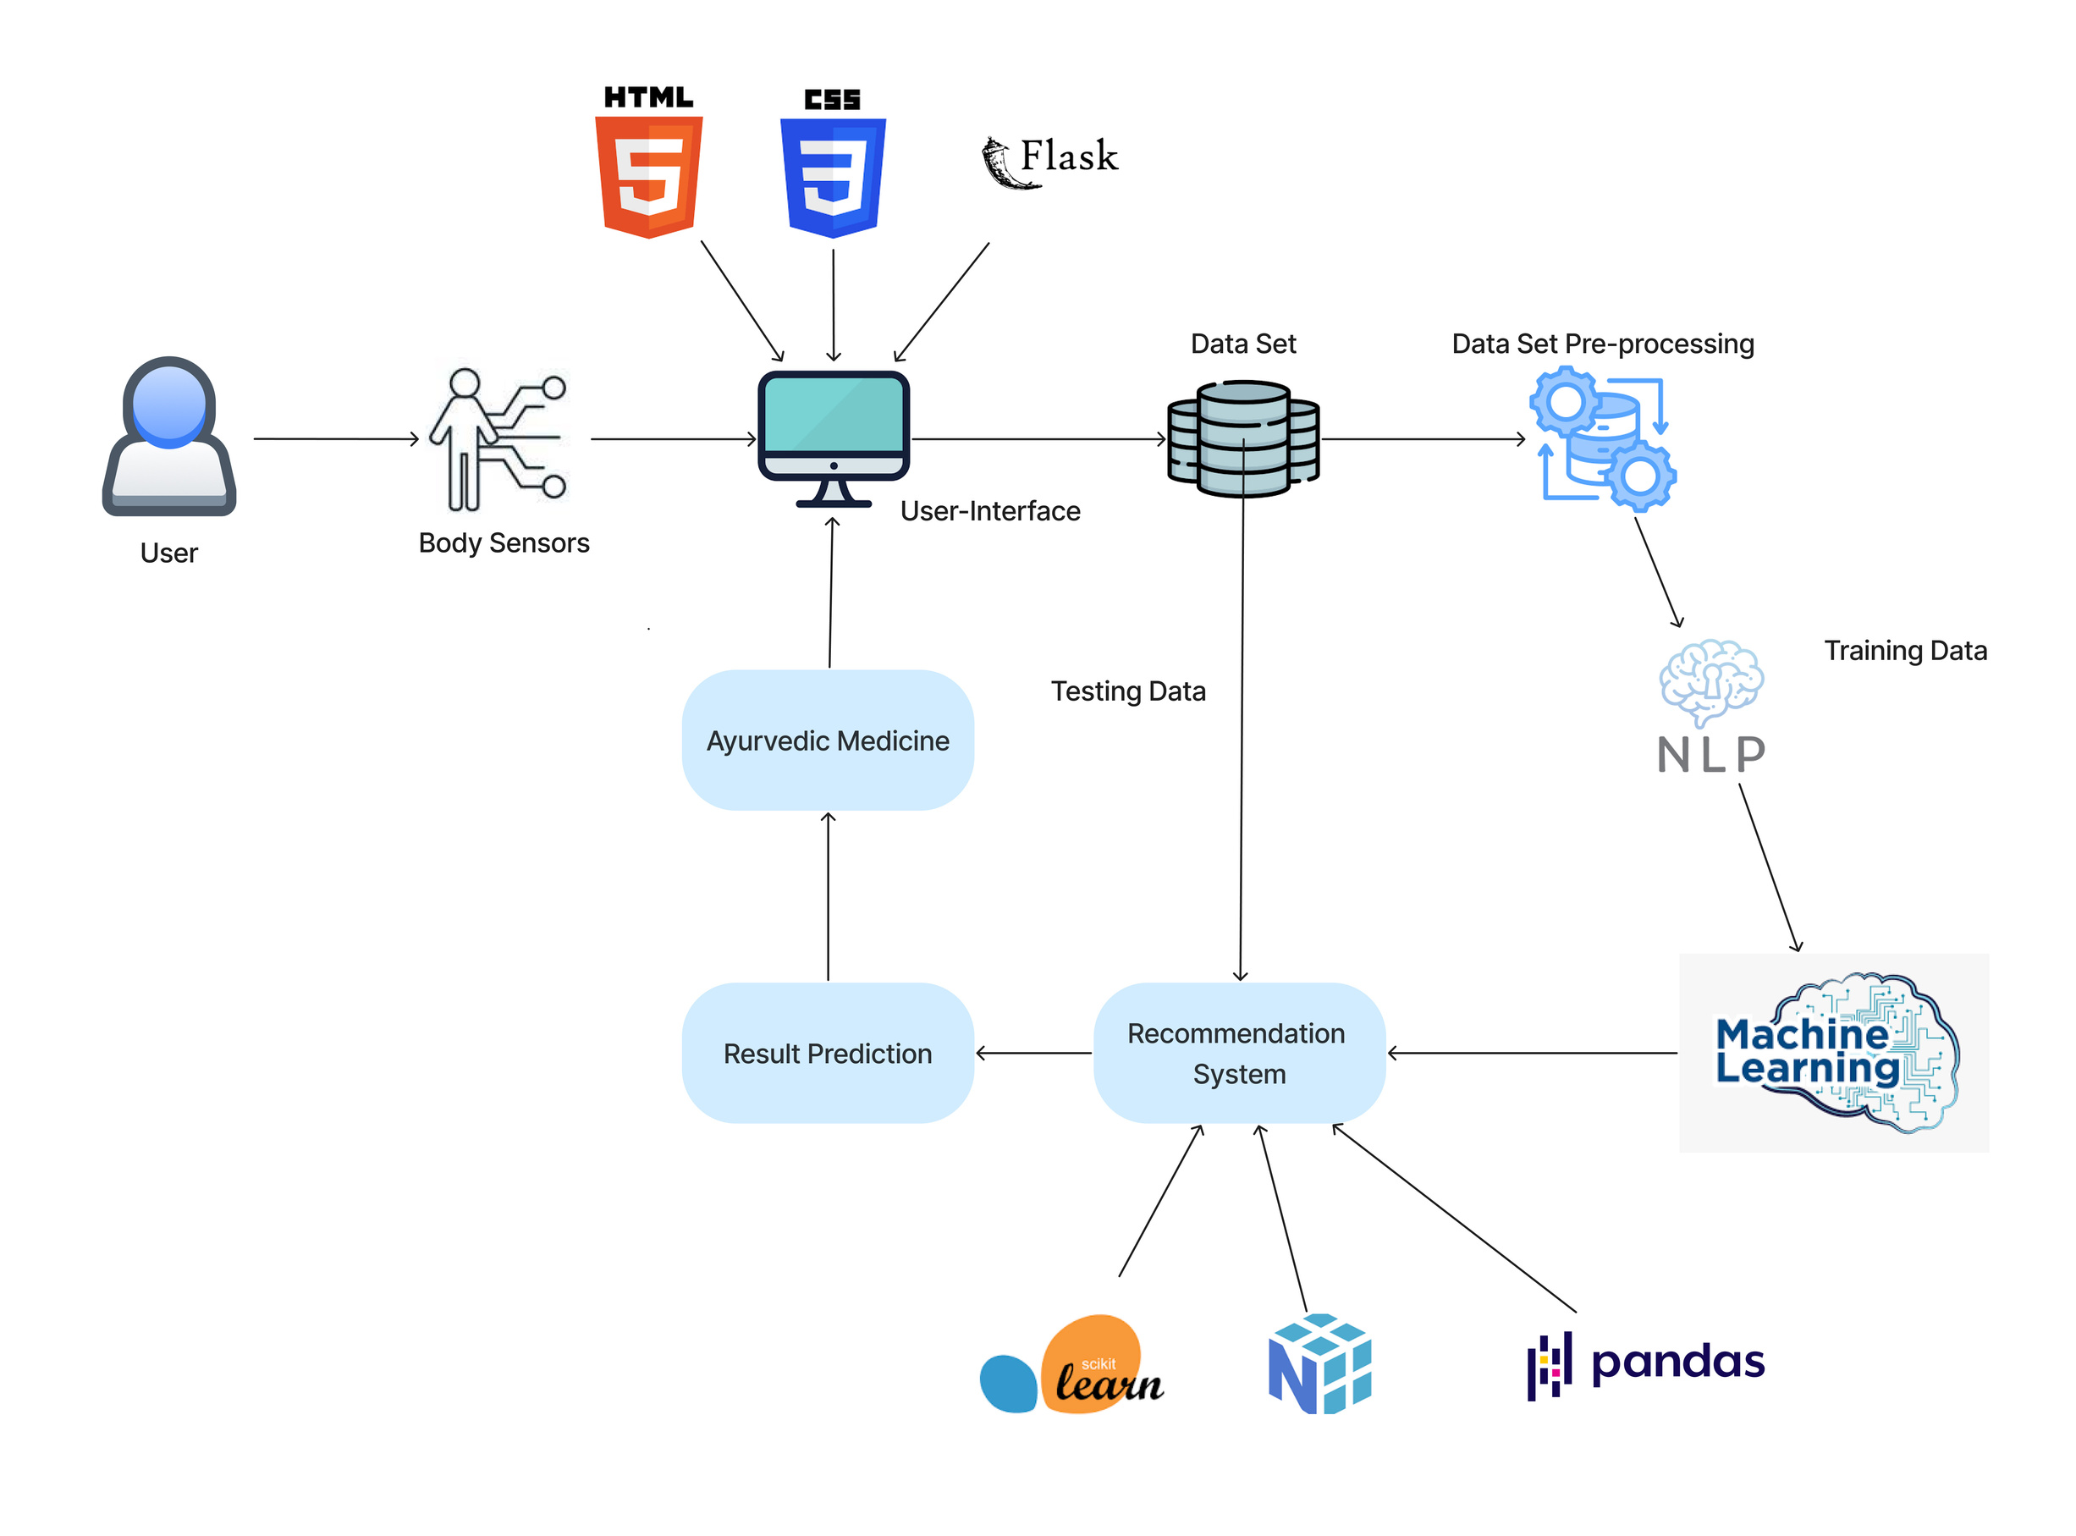
Hardware & Software requirements

Slide 9
Conclusion
Today, the cost of health care is constantly rising, and affecting people's ability to afford health coverage. Drug-based medicines are being unaffordable for economically poor countries like India and problematic in the Western countries due to numerous side effects. The drug should be the last rather than first mean of treatment, beginning with the natural healing method like Ayurveda. One of the Ayurvedic treatment modalities such as Panchkarma can remove disease before its manifestation.
This Ayurvedic medicine recommender system presents a unique opportunity to bridge the gap between ancient wisdom and modern technology. By leveraging the principles of Ayurveda – like understanding your dosha and utilizing natural remedies – alongside personalized recommendations, this system can empower individuals to take a proactive approach to their health and well-being.

Slide 10
1.World Health Organization. Global Strategy on Digital Health 2020-2025. Geneva: World Health Organization; 2021.
References
2. Vyas, Hitesh & Panara, Kalpesh. (2019). DETERMINATION OF ANUKTA DRAVYA THROUGH CLASSICAL AYURVEDIC PRINCIPLES. Journal of Research and Education in Indian Medicine (Est.1982).
3.Rajput, D. S.(2020).Evolution, ayurveda, immunity, and preventive aspects for emerging infectious diseases such as COVID-19

Slide 11
Thank you

